Slide 1

Concurrency: Reactive vs Shared State
Benchmarking Akka actors against shared-state concurrency
June 17th, 2015

Slide 2

ABOUT ME | DANA PEELE, SR APPLICATION DEVELOPER
Developer
Rock climber
Dad
Scala junkie

Slide 3




Four E-commerce banners
NOT an agency
Strong engineering culture
Incredible stacks
Scala/Play/Akka/Mongo
React/Backbone/Marionette

Slide 4
Concurrency
Multiple threads executing simultaneously
Our example- an inventory web service with multiple clients making requests in parallel
Challenge- ensure that we don’t sell inventory we don’t have
Inventory Web Service

Slide 5
Options to Handle Concurrency
Shared-State
Akka (Reactive)
Other:
Function Reactive Programming
Publisher/Subscriber
Communicating sequential processes
Software transactional memory
Notes:
Function Reactive Programming (Not the same as Reactive)- composable streams
Publisher/Subscriber- ex JavaScript event handling
Communicating sequential processes- similar to actor model (Akka) but messages are synchronous and processes are anonymous
Software transactional memory- analogous to database transactions, built into Clojure and implemented in many languages (Java, Haskell, Ocaml)

Slide 6
Shared-State
Shares mutable state across threads
Uses locks/synchronized blocks to prevent race conditions
Proven and well understood
In widespread use for a long time
Simple to reason about for trivial applications
Complex applications are very difficult to model
Thread sleep/awake is expensive
Deadlocks!

Slide 7
Akka (Reactive)
Actors instead of threads
Actors communicate with message passing
Mutable state, but…
Each actor has a mailbox (queue)
Loose coupling
Requires care in modeling and refactoring to ensure resiliency and performance
Dangerous tasks and mutable state don’t mix and require supervision
Can’t multi-thread mutation
Notes:
Actors instead of threads
Lightweight, easy to reason about (actor’s are like people… specialized and one task at a time), delegate and supervise
Actors communicate with message passing
Messages are objects containing information, they aren’t imperative, they’re reacted to
Mutable state
But only an actor can change itself (state isn’t shared)
Each actor has a mailbox (queue)
Synchronous message processing (No locks, blocking, or thread sleep)
Loose coupling
Messages are strongly typed, receive method that processes them isn’t

Slide 8
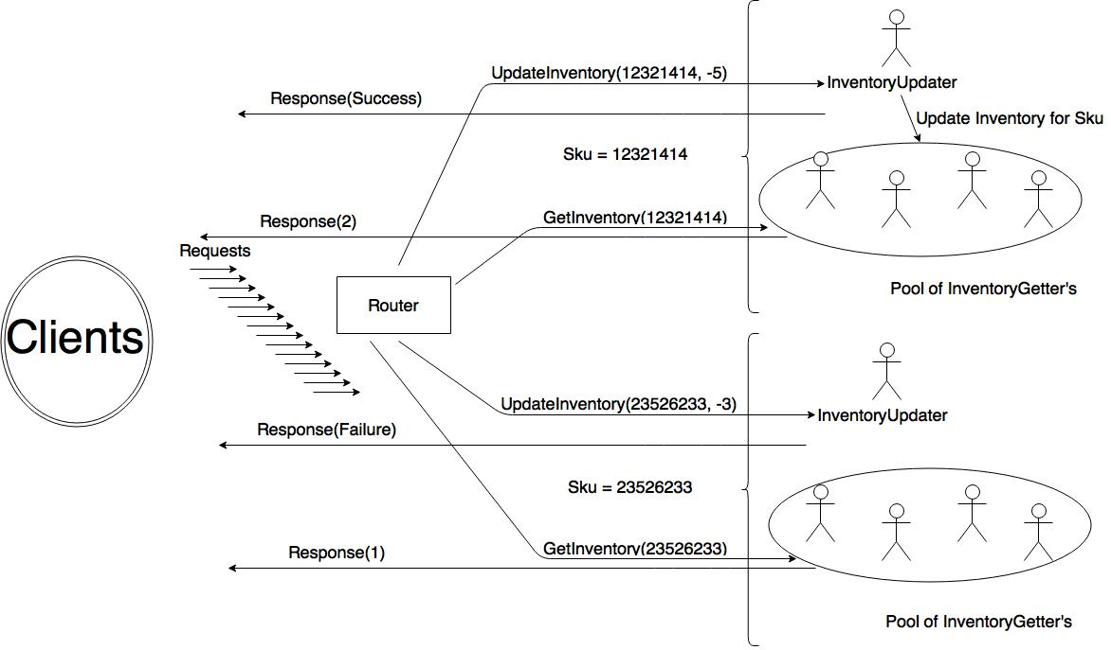

Slide 9
DevOps
At HBC we are using
Kitchen (testing)
Vagrant (virtual machines)
Puppet (provisioning)
Librarian Puppet (more provisioning)
Docker (containers)
We practice Infrastructure as code
versioning
pull requests
code review
regression testing
reproducibility
Linux base box
Puppet Librarian
to source modules for SBT, Java, MongoDB, and Docker
Installed in my base box (provision)
spin up and deploy a Docker container running StatsD and Graphite
Run Play applications with SBT and Java while running MongoDB, StatsD, and Graphite instances ready to use.
Notes:
Right column is Dev Ops used in this demo. Now let’s look at code!!!

Slide 10
Inventory Applications- Shared Elements
Play web framework
Built on Akka
Netty web server, a non-blocking I/O client-server framework (Originally developed by JBoss)
Incorporates logging and configuration management
ReactiveMongo
Non-blocking, asynchronous MongoDB driver built on Akka Streams
Database ops return an immediately future and (may) eventually complete
Metrics
StatsD (aggregator): data received via one-way udp protocol, sends to Graphite
Graphite: Dashboard web application

Slide 11
Shared-State Inventory Application
Application controller
Uses TrieMap of InventoryQuantity instances keyed to product sku (id)
val inventory = TrieMap[String, InventoryQuantity]()
val r = scala.util.Random
for (sku <- 1 to 100) {
val quantity = r.nextInt(10000) + 10000
inventory.put(sku.toString, new InventoryQuantity(quantity))
mongoRepo.setInventory(sku.toString, quantity)
}
Handler methods
Notes:
Handler methods
getInventory
updateInventory
Persists the new value to Mongo if quantity changes
Both handler methods respond to the request and then send out metrics.

Slide 12
Shared-State: updateInventory handler
def updateInventory(sku: String, quantityChange: Int) = Action.async ({
request =>
val startTime = System.currentTimeMillis
val f = Future {
Logger.debug("update inventory called")
val skuInventoryOption = inventory.get(sku)
var result = NotFound(Json.toJson(InventoryResponseModel("update", sku, success = false, 0, "sku not found")))
skuInventoryOption match {
case Some(skuInventory) =>
val response = skuInventory.updateQuantity(quantityChange)
result = Ok(
Json.toJson(
InventoryResponseModel(
"update", sku, success = response._1, quantityChange, if (!response._1) s"Only ${response._2} left" else ""
)))
response._1 match {
case true => mongoRepo.setInventory(sku.toString, response._2)
case _ =>
}
case _ =>
}
result
}
f.onComplete({case _ =>
statsDSender ! SendTimer("shared-state.update.duration", System.currentTimeMillis - startTime)
statsDSender ! IncrementCounter("shared-state.update.count")
})
f
})
}

Slide 13
Shared-State: InventoryQuantity Model
def updateQuantity(quantityUpdate: Int): (Boolean, Int) = {
var returnValue: (Boolean, Int) = (false, quantity)
writeLock.lock()
quantityUpdate >= 0 || quantity + quantityUpdate >= 0 match {
case true =>
quantity += quantityUpdate
returnValue = (true, quantity)
case _ =>
}
writeLock.unlock()
returnValue
}
Notes:
Dirty reads but synchronized writes using a lock.

Slide 14
Reactive Inventory Application
Application controller
Actor system- actor hierarchy that shares configuration.
Play has it’s own internal actor system that we can use if we only have a couple of actors.
But since we have 1100 actors and we’re expecting a lot of load on the site we create another actor system to separate the http server from the application layer.
Next we initialize our actors.
For each sku we instantiate an InventoryUpdater actor and a pool of 10 InventoryGetter actors.
This bring up a crucial point in regards to Akka design.
We don’t have a pool of actors with access to all inventory, that would require shared-state which we are avoiding.
So instead we essentially shard the data by sku so that we are able to multithread the processing.
Another important line here is:
inventoryUpdater ! RegisterListener(routee)
We’ll look at the code in the actors related to this later but what is happening here is that each of the 10 InventoryGetter’s is registering with the corresponding InventoryUpdater so that when it changes the inventory it can send them a message to tell them to update their inventory as well.
Finally we have the getInventory and setInventory controller methods.
They send a message to the appropriate actor
Now lets look at some actors.
First we’ll look at is the EventSource actor. This actor is actually just a trait that we will mix in to the InventoryUpdater actor that allows the InventoryGetter actors to register to receive messages.
In this partial function of type Receive we accept messages to register and unregister listeners and store them in a vector.
Now we move to the InventoryUpdater. Again we have a companion object defining messages. Then looking at the class, we can see that this actor take constructor parameters to store state: the sku controlled by this actor, the current quantity, a reference to the mongo helper for persisting data, and a reference to the statsD actor for sending metrics.
We can also see that it mixes in several traits- EventSource to register listeners it can publish to, ActorLogging, which gives us the ability to log from this actor, and InventoryResponse which exposes the implicit combinator we need to convert InventoryResponseModel instances into json.
The next thing we see is a method to persist the inventory for this sku to the database and an immediate call to this method to set the initial inventory when this actor is created. Again, since we are using Reactive Mongo this call is completely non-blocking, resulting in an immediate future being returned. We aren’t handling failure except to log it.
Next we define a partial function, to handle incoming requests to modify the inventory. This confirms that the request is valid (i.e. we have enough inventory to satisfy it), updates the quantity, sends a message to all the listeners (the InventoryGetter’s) to update their inventory, and persists to mongo if appropriate, completes the future to send the response back to the http client with the appropriate information, and sends metrics.
Finally we set the receive method for this actor (where all incoming messages are sent) to a combination of the partial function we just defined and the one from the EventSource trait by using orElse. Basically this says, if the message isn’t handled by the first partial function, try the 2nd one.
Now lets look at the InventoryGetter. Nothing new here, companion object, mutable inventory state, updates inventory when it receives a message from the InventoryUpdater, responds to requests for the current inventory for the sku it controls, and sends metrics.

Slide 15




Q&A

Slide 16
Obligatory We Are Hiring Slide
Surprise! We are hiring.
Follow us:
Twitter: @HBCDigital
LinkedIn: https://www.linkedin.com/company/hbc_digital?trk=biz-companies-cym
Contact Info:
dana_peele@s5a.com
@Dana_S_Peele
Repo for the demo and slideshow:
https://github.com/saksdirect/react-vs-shared-state-inventory

